Slide 1
Cyber Cyber City
Macrohard
Alister Lawson
Bruce Fernandes
Jamie Mano
Marek Bettzig
Nick Biagioni

Slide 2
agenda
Project Update
  Standards
  Requirements
  Design
Test Plan
  Key testing challenges
  Testing Timeline
  Test Cases and Process
2. Test Components
  Software Tools and Environment
  User Action Scripts
  Executables
3. Test Files and Resources
  Version control and branch structure
  Test Directory Structure
  Testing Dependencies

Slide 3
Project Update
Standards
Requirements
Design

Slide 4
STANDARDS
Overall improvement to the document
  Introduction to each section
  Converted bulletpoints into fulltext
Added peer review step before merging to development process
Align documentation of branch model to existing repo

Slide 5
REQUIREMENTS
Global document renovations
  Better describes project to team and clients
  Elaboration on high-priority components
  GUI merged into other chapters, chapter 6 now describes example game requirements
Revamped lists of feature behaviours for all components
  More detail added to sections that were lacking
  Standardised summary then bullet-points structure
Removal of extraneous information
  Scope creep

Slide 6
DESIGN
Global document renovations
  Structural changes to better fit object orientented implementation
  Removal of information that didn't belong in design
Elaboration of each component's logical design
  Diagrams added to clarify designs
  Abstraction level lowered to functions with parameters
High level full-program ERD
  Relationship between all nodes (objects) in the main scene and mainline data path
  Hierarchy displayed to clarify efforts in reduced coupling

Slide 7
2. TEST PLAN
Key Testing Challenges
Testing Timeline
Testing Cases and Process

Slide 8
KEY TESTING CHALLENGES
"Cyber Cyber City's base functionality is a library of executables, presented as an arcade. It is made so creators may populate it with arcade-style games, for a player to browse and play."
Player's perspective versus Creator's perspective
Automation of tesing states based on user-generated files
Poor DirAccess Documentation

Slide 9
TESTING TIMELINE
Bottom-up priority for test creation
  "Design" tests first to ensure base program functionality
    Split test creation by component to each member
    One complete pass of all component's tests prior to moving to second part
  "Requirements" test second to ensure any unexpected behaviour isn't from lower level issues
    Split test creation by component to each member
    Review of previous test cases based on requirements tests
Final run of all combined tests

Slide 10
TESTING CASES AND PROCESS
"Creator" and "Player" roles
Subjective cases
  Inspections of arcade elements
  Navigation of arcade
Objective cases
  Parameters and return values
  Components in the program where correct behaviour can be measured with scripts

Slide 11
3. TEST INFRASTRUCTURE
Software Tools and Environment
User Action Scripts
Executables

Slide 12

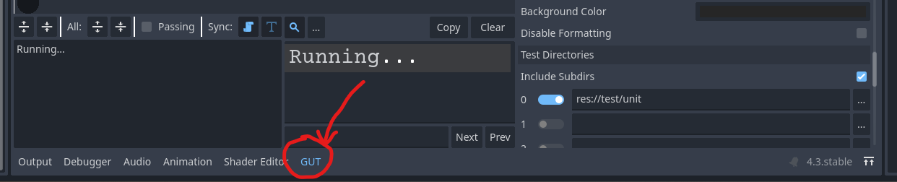
Software tools and Environemnet
Within Godot Editor
some of the test will use window's file explorer
We are using Windows 11
Godot Unit Tester (GUT) Plugin
  It allows you to write tests for your gdscript in gdscript.
  What's included in the class: setup/teardown, assertion, utilities, and GUT utilities

Slide 13
Software tools and Environemnet contd.
Automated testing will be performed using user action scripts to ensure consistent test coverage.
We will test using gdscripts (GUT) stub for specific parts like functions.
Tools and Utilities will remain under the Godot Editor and the use of GUT Plug-in.

Slide 14
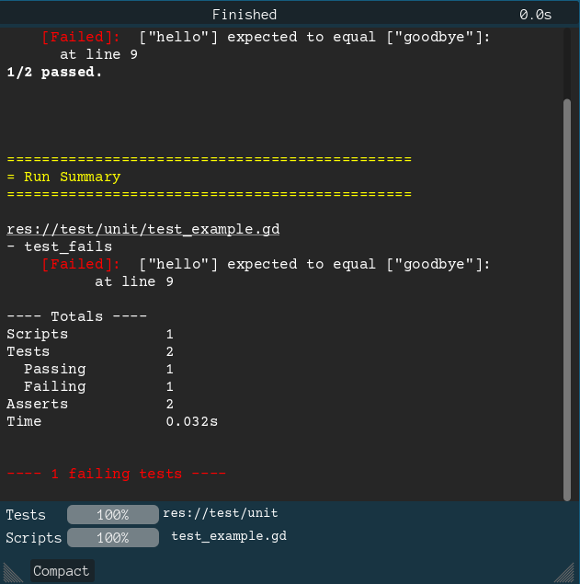
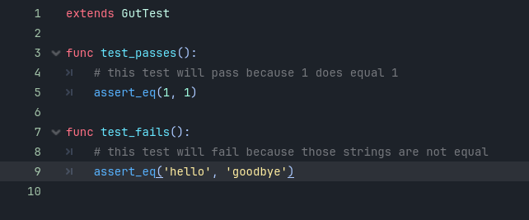
Sample Input/output
Test_example.gd

Slide 15
User Action SCRIPTS
Used for multi-tool actions performed by creators (game file manipulation)
Used for player character behaviour tests
Description:
  Step-by-step guides for consistent and reproducible manual testing.
  Detail specific tester actions, expected behavior, and pass/fail criteria.
  Include prerequisites, precise instructions, and result assessments.
  Ensure reliability and clarity in validating product features.

Slide 16
User Action SCRIPT Example Part 1
Step 1: Verify the First-Person Point of View
  Observe the screen. Ensure the Field of View (FOV) is set to 90 degrees.
  Move the camera left, right, up, and down by dragging the mouse.
    Expected Result:
      Horizontal camera rotation is infinite.
      Vertical camera rotation locks 90 degrees up and down from the horizon.
Step 2: Test Basic Movement Controls
  Press W: The player character moves forward at approximately 1.4 meters per second.
  Press S: The player character moves backward at the same speed.
  Press A: The player character strafes left at the same speed.
  Press D: The player character strafes right at the same speed.
    Expected Result: Movement corresponds to the input key, matches the described speed, and appears smooth.

Slide 17
User Action SCRIPT Example Part 2
Step 3: Test Interaction Range
  Approach an interactable object (e.g., a glowing button) within 2 meters of the player character.
  Ensure the object is aligned with the center of the screen.
  Press Left Click to interact.
    Expected Result:
      The defined behavior of the object (e.g., the button lights up or a door opens) occurs.
      No interaction occurs if the object is outside the 2-meter range or not aligned with the screen center.
Step 4: Boundary Testing for Interaction
  Move the player character just outside the 2-meter range of the object.
  Press Left Click to attempt interaction.
    Expected Result: No interaction occurs.
  Move the object off the center of the screen but within 2 meters.
  Press Left Click to attempt interaction.
    Expected Result: No interaction occurs.

Slide 18
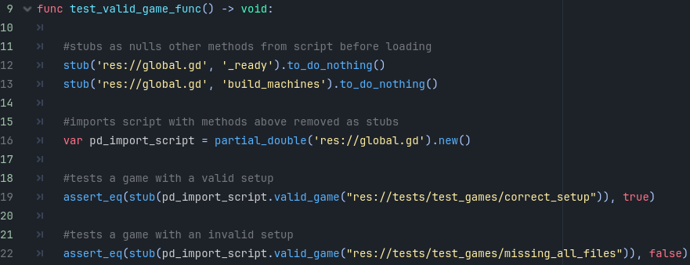
EXECUTABLES
Test scripts written in gdscript

Slide 19
4. TEST FILES AND RESOURCES
Version control and branch structure
Test Directory Structure
Testing Dependencies

Slide 20
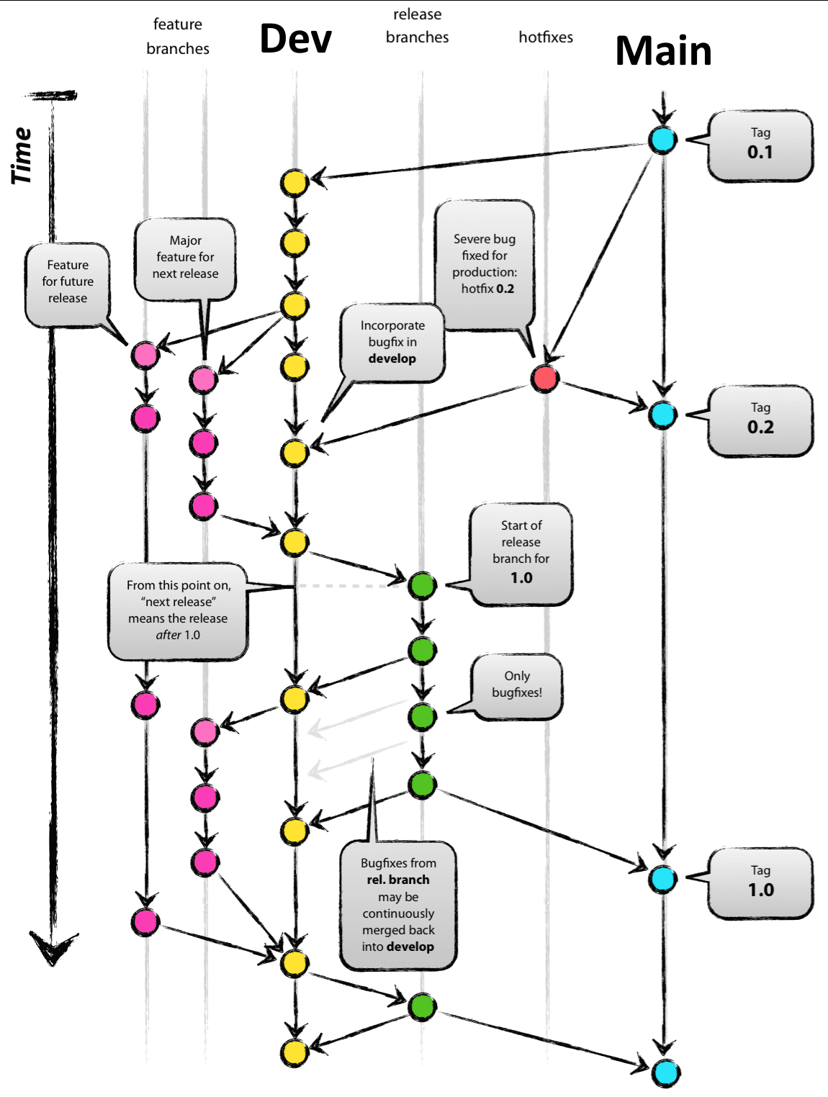
Version control and branch Structure
Testing files directory treated like a "feature" in version control
All files included in project directory, but will be excluded from final program compilation
Done on same branch as Dev but each test is branched as a feature

Slide 21
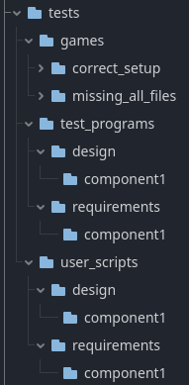
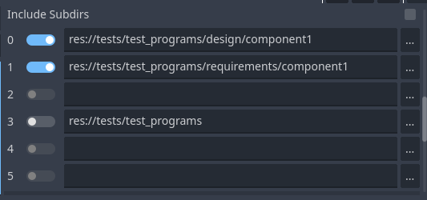
Testing Directory Structure
All within development branch game directory
Separated by user scripts and test programs
Test games setup for test cases from both
Each subsection split into design and requirements folders
Arranged for easy picking of layers for test programs with GUT

Slide 22
Test Dependencies
Windows 10-11 operating system
A file explorer or command shell
Project imported into Godot editor (GUT addon bundled in dev branch project folder)

Slide 23
ENd

